Slide 1

May 2018
Bangalore
Data Management in R
May 2018
Bangalore

Slide 2

WORKING WITH MESSY DATA
What we will cover
How it will help you
Simplify data manipulation pipeline
Handling missing values with ease
Tidy data formats
Tidy data packages
Dealing with missing values

Slide 3
TIDY DATA
WHICH FORMAT DO YOU PREFER TO WORK WITH?
A
C
STORE | BISCUIT |  | CEREAL
 | JAN | FEB | JAN | FEB
1234 | 100 | 120 | 90 | 50
4231 | 80 | 85 | 100 | 120
STORE | MONTH | CAT | SALES
1234 | JAN | BISCUIT | 100
4231 | JAN | BISCUIT | 80
1234 | JAN | CEREAL | 90
4231 | JAN | CEREAL | 100
1234 | FEB | BISCUIT | 120
4231 | FEB | BISCUIT | 85
1234 | FEB | CEREAL | 50
4231 | FEB | CEREAL | 120
B
STORE | CAT | JAN | FEB
1234 | BISCUIT | 100 | 120
4231 | BISCUIT | 80 | 85
1234 | CEREAL | 90 | 50
4231 | CEREAL | 100 | 120

Slide 4
TIDY DATA – DATA SEMANTICS
A dataset is a collection of values
Values are organised in two ways. Every value belongs to a variable and an observation.
A variable contains all values that measure the same underlying attribute (like height, temperature, duration) across units.
An observation contains all values measured on the same unit (like a person, or a day, or a race) across attributes.
Source: Wickham, H. (2014). Tidy Data. Journal of Statistical Software, 59(10), 1 - 23. doi:http://dx.doi.org/10.18637/jss.v059.i10

Slide 5
TIDY DATA – DATA SEMANTICS
STORE | BISCUIT |  | CEREAL
 | JAN | FEB | JAN | FEB
1234 | 100 | 120 | 90 | 50
4231 | 80 | 85 | 100 | 120
What are the variables of this dataset?

Slide 6
TIDY DATA – DATA SEMANTICS
STORE | BISCUIT |  | CEREAL
 | JAN | FEB | JAN | FEB
1234 | 100 | 120 | 90 | 50
4231 | 80 | 85 | 100 | 120
What are the variables of this dataset?

Slide 7
TIDY DATA – DATA SEMANTICS
TIDY DATA
Each variable forms a column.
Each observation forms a row.
Each type of observational unit forms a table.
Source: Wickham, H. (2014). Tidy Data. Journal of Statistical Software, 59(10), 1 - 23. doi:http://dx.doi.org/10.18637/jss.v059.i10

Slide 8
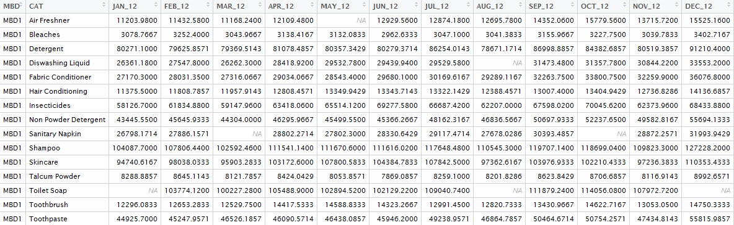
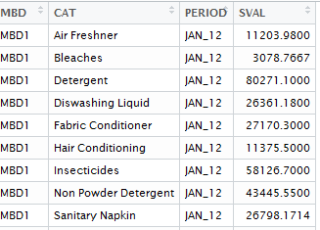
TIDY DATA – DATA SEMANTICS
data set: sales_pivot_missing.txt

Slide 9
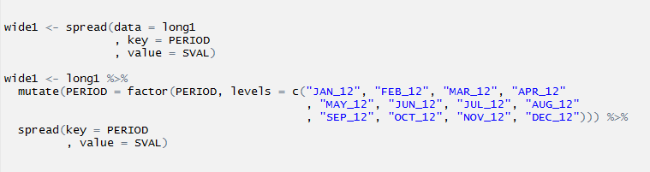
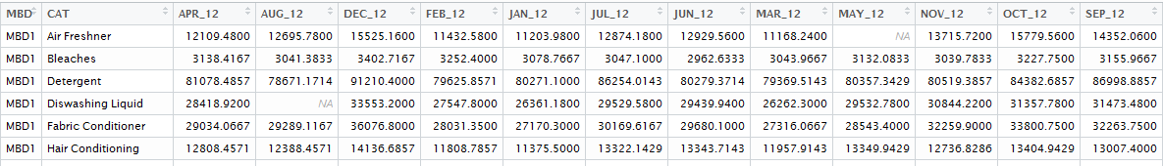
tidyr – Long to Wide (melt())
Is wide1 identical to sales?

Slide 10
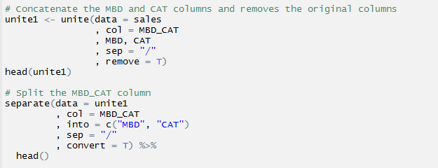
tidyr – unite() and separate()
The `unite` function concatenates columns in a data.frame
The `separate` function splits up a column into multiple columns based on the separator

Slide 11
Summary of key tidyr functions
● gather() - Gather columns into key-value pairs
● spread() - Spread key-value pairs into columns
● separate() - Separate one column into multiple
● unite() - Unite multiple columns into one

Slide 12
First look at the data
Import
Typically data is imported from excel or other databases such as Oracle, MySql etc. Always check dimensions, variable types and first few rows of data after import.
Data Health Check
Check each variable for missing data, inconsistent data and incorrect data.
3 C’s of good data: Complete, Correct and Consistent
Data Cleaning
Wherever possible, clean the data before starting statistical analysis.

Slide 13
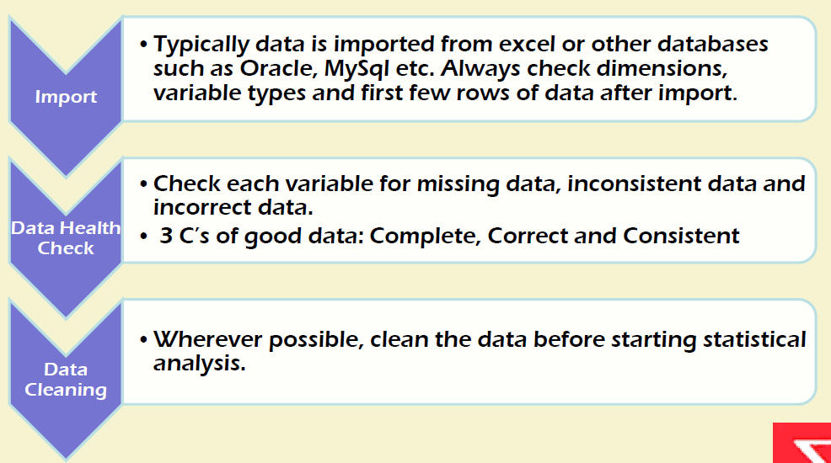

Slide 14
MISSING VALUES IN R
Represented as NA
Operations on data with NA will likely result in NA
is.na: returns a logical vector as to whether each element is NA
na.omit: returns rows of the data.frame with no NA entries
complete.cases: returns indices of rows of the data.frame with no NA entries
na.rm = …: a common option in vectorized functions (e.g., sum, mean, max, min) to ignore NA when computing the values

Slide 15
SUMMARY
Tidy data, together with a complete code book, eases data analysis and manipulation
tidyr can be used to convert data from wide to long formats (and vice-versa) easily
is.na, na.omit, complete.cases and na.rm are useful functions/options to use in dealing with missing values
Page 15

Slide 16
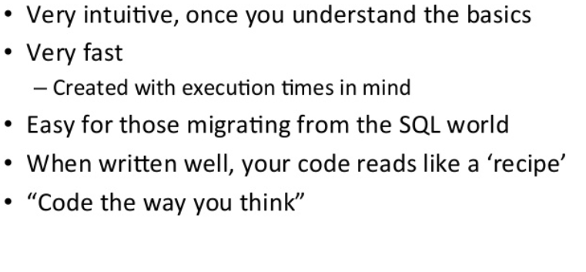
Why Use Dplyr

Slide 17
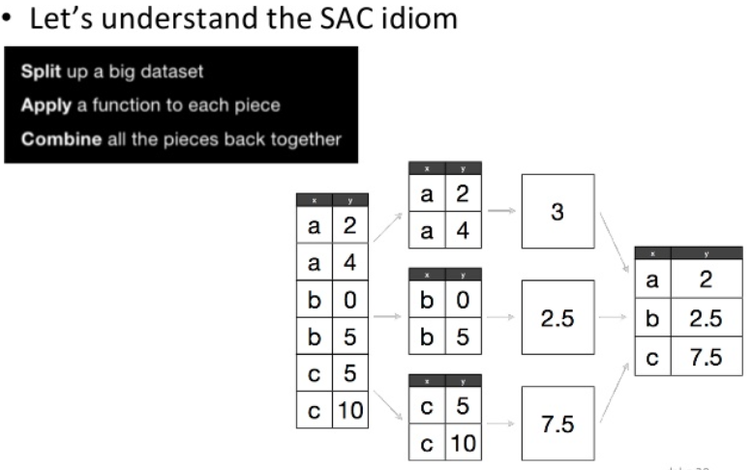
Split-Apply-Combine

Slide 18
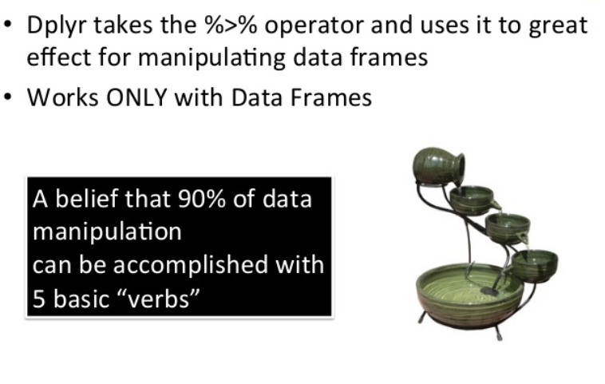
Pipe(%>%) Operator

Slide 19
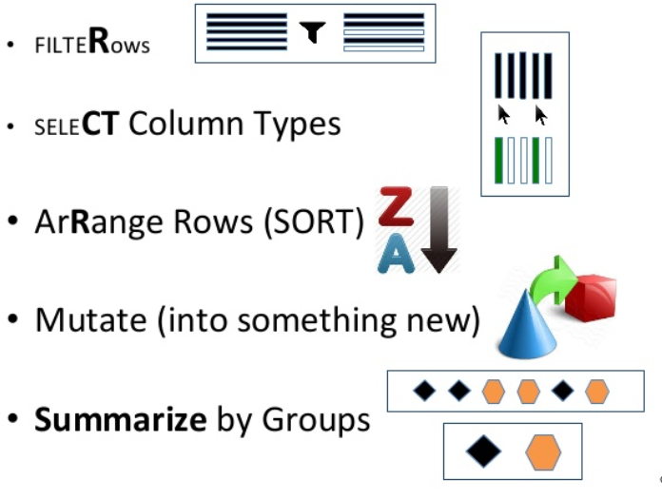
Components of a Dplyr Package

Slide 20
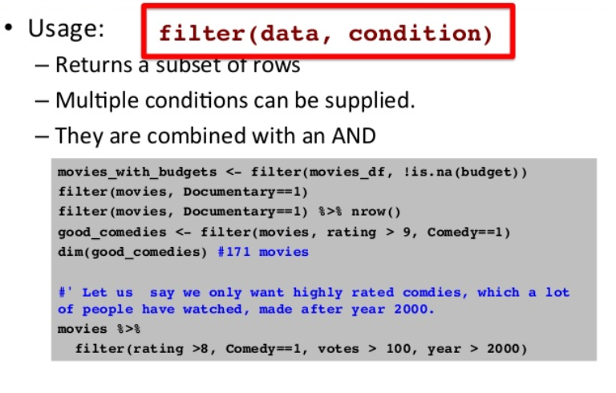
Filter()

Slide 21
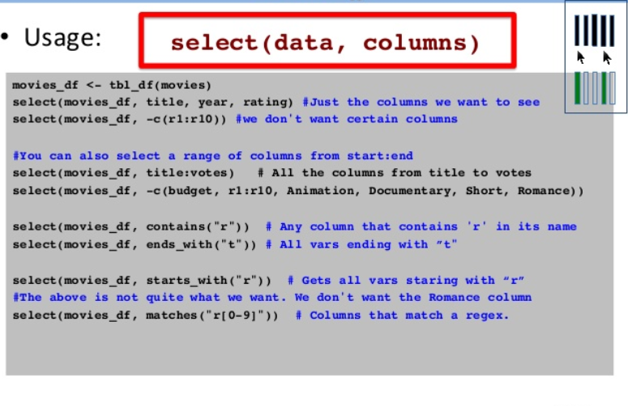
Select()

Slide 22
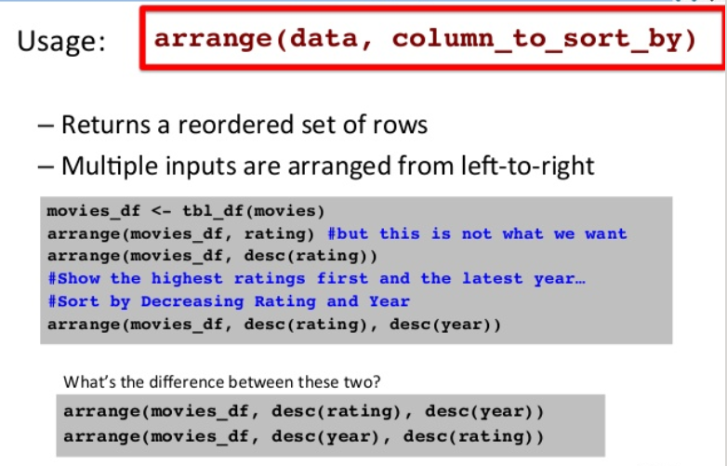
Arrange()

Slide 23
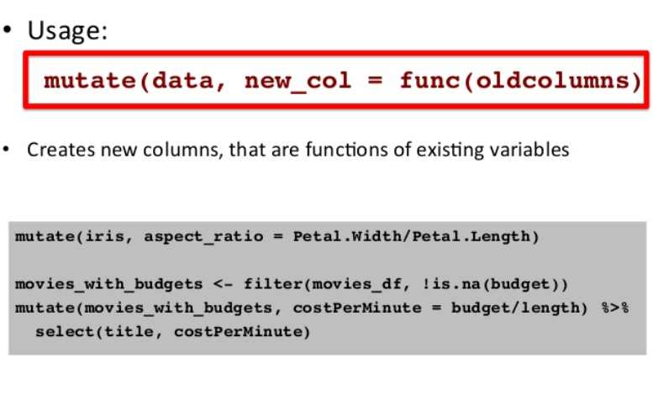
Mutate()

Slide 24
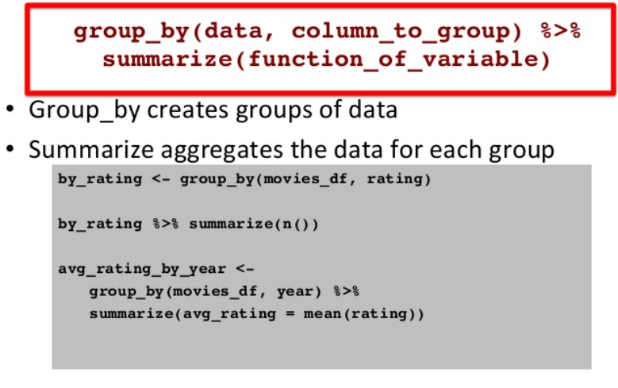
Group By()

